Slide 1
Evolutionary model for the statistical divergence of paralogous and orthologous gene pairs generated by whole genome duplication and speciation
Yue Zhang, Chunfang Zheng, David Sankoff
Presented by Suzy Sun

Slide 2
Comparative Genomics
Introduction
Seeks to infer the nature and timing of evolutionary events by examining the distribution of similarities between orthologous and paralogous gene pairs
Identify peaks as duplications that were generated by speciation or whole genome duplication (WGD) events
However, there is no rigorous methodology to calculate the volume of the individual normal distributions

Slide 3
Purpose
Introduction
Analyze duplicate gene similarity distributions based on sequence divergence and fractionation of duplicate genes that result from whole genome duplication (WGD) for
Series of 2 or 3 WGD
Whole genome triplication followed by WGD
Triplication, followed by speciation, then WGD
Calculate probabilities of possible gene pairs to predict the number of surviving pairs from each event

Slide 4
Gene events
Introduction
Speciation creates a set of orthologous gene pairs that evolve through random single nucleotide mutations
Whole genome duplication (WGD) creates a set of paralogous gene pairs that also diverge through random mutation
Fractionation: one of the two genes is excised, pseudogenized, or otherwise removed as a coding gene

Slide 5
Building blocks
Introduction
p = proportion of nucleotide positions occupied by the same base in two orthologues/paralogs
G = gene length (number of nucleotides in the coding region)
Assume p follows a normal approximation to the sum of G binomial distributions, divided by G, over time t ϵ [0,∞) since the event that gave rise to the gene pair
Mean: E[p] = $\frac{1}{4}$ + $\frac{3}{4}e^{−λt}∈$ [0,1]
Variance: E(p-E[p])² = $\frac{3}{16} \frac{(1+3e^{−λt})(1−e^{−λt})}{G}$
Where $λ>0 is a divergence rate parameter$

Slide 6
Building blocks
Introduction
Fractionation can be represented by u $∈$ [0,1]
u = probability, for a pair of genes, that neither gene is lost over a time interval t
The assumption that any gene pair has a constant probability of fractionation is
u = $e^{−ρt}$
where $ρ$ is the fractionation parameter

Slide 7
GENE EVENTS
Consider 4 cases:
Two WGD
Three WGD
Whole genome triplication followed by WGD
Whole genome triplication, followed by speciation, followed by WGD

Slide 8
Two WGD
Two WGD

Slide 9
Two WGD
Two WGD
u is the probability, for a pair of genes, that neither gene is lost over the time interval t_{1,} and similarly, v for time interval t₂

Slide 10
Two WGD
Two WGD
u is the probability, for a pair of genes, that neither gene is lost over the time interval t_{1,} and similarly, v for time interval t₂

Slide 11
Two WGD
Two WGD
In Figure 1, let
A | = | E(t₁ pairs)
 | = | 4uv² + 4uv(1-v) + u(1-v)²
 | = | u(1+v)²
B | = | E(t₂ pairs)
 | = | 2uv² + 2uv(1-v) + (1-u)v
 | = | v(1+u)
C | = | E(unpaired genes)
 | = | (1-u)(1-v)

Slide 12
Two WGD
Two WGD
In Figure 1, let
P(A) | = | Proportion of t₁ pairs
 | = | $$\frac{A}{A+B+C}$$
P(B) | = | Proportion of t₂ pairs
 | = | $$\frac{B}{A+B+C}$$
P(C) | = | Proportion of unpaired
 | = | $$\frac{C}{A+B+C}$$

Slide 13
Two WGD
Two WGD
Let N_{p}(s) = the density at point s of a normal distribution with mean p and variance $\frac{p(1−p)}{G}$
Probability that a gene pair will have similarity $s∈\left[0,1\right]:$
$$Q\left(s\right)=P(A)\text{N}\text{p}\text{1(}\text{s}\text{) }\text{+ }\text{P}\text{(}\text{B}\text{)}\text{N}\text{p}\text{2}\text{(}\text{s}\text{)}$$
Probability of an unpaired gene is
$$Q∗ =P(C)$$
The likelihood of a dataset with gene pairs at s₁,…,s_{l} and k unpaired genes is
$$ℒ=\prod_{i=1}^{l}{Q\left(s_{i}\right)Q^{∗k}}$$
The log likelihood $L$ = log $ℒ$ is
$$L=\sum_{i=1}^{l}{logQ\left(s_{i}\right)}+k logQ^{∗}$$
$$=\sum_{i=1}^{l}{[\log{(\left.P\left(A\right)N_{p1}\left(s_{i}\right)+P\left(B\right)N_{p2}\left(s_{i}\right)\right)]}}+k logQ^{∗}$$

Slide 14
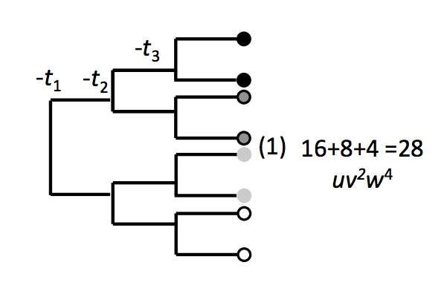
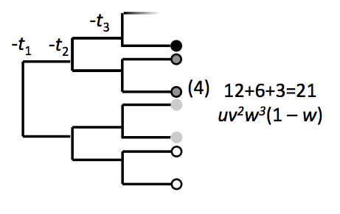
Three WGD
Three WGD

Slide 15
Three WGD
Three WGD
For Figure 2 where u, v, w are retention probabilities for t₁ , t₂ , t₃
E(t₁ pairs) = (1 - 3w² + 2w)uv² + (2 + 6w² + 4w)uv + (1 + w² + 2w)u
E(t₂ pairs) = ((1 + w² + 2w)u + 1 + w² + 2w)v
E(t₃ pairs) = -2uv²w² + ((2w² – w)u + w)v + uv +w
E(unpaired) = (1-u)(1-v)(1-w)

Slide 16
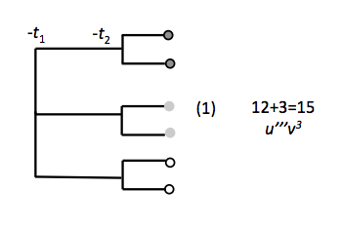
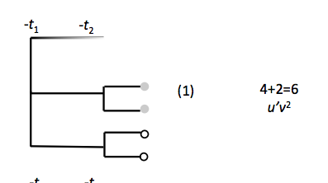
WG Triplication + WGD
WGT + WGD
E(t₁ pairs) = (u’+3u’’’)v²+(2u’ + 6u’’’)+b+3u’’’
E(t₂ pairs) = -3u’’’v³+3u’’’v²+(1+2u’’’-u’)v
E(unpaired) = (1-u’’’-u’)(1-v)

Slide 17
Speciation
Speciation

Slide 18
Speciation
Speciation
Whole genome triplication (t₁)
Speciation (t₂)
WGD in one of the daughter genomes (t₃)

Slide 19
Speciation
Speciation

Slide 20
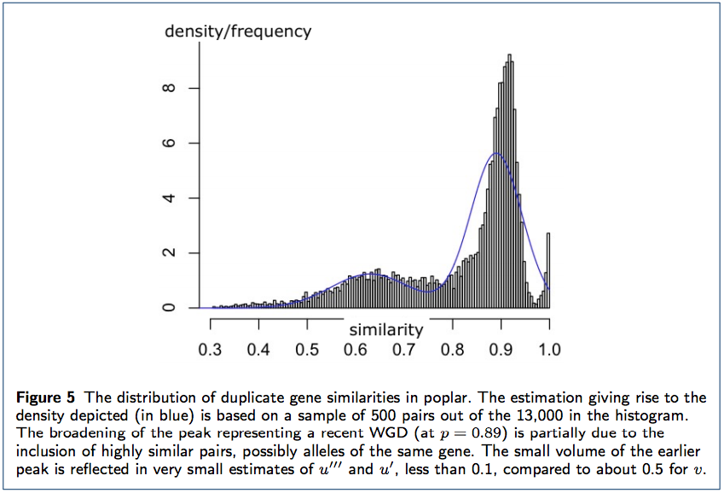
Application to Populus trichocarpa
Notes:
Populus trichocarpa, the black cottonwood, western balsam-poplar or California poplar, is a deciduous broadleaf tree species native to western North America.

Slide 21
Limitations
Length is variable among genes and genomes
Duplicate genes are produced not only by WGD
Assumption of constant rates of gene divergence
Fractionation rates are not well understood

Slide 22
Conclusions
This is the first model that simultaneously processes duplicate gene divergence and fractionation through the course of evolution of one or more species that underwent WGD
We can predict the location, shape and amplitude of evolutionary signals in pairwise genome comparisons

Slide 23
Thank you!

